Slide 1
Collaborative Platform 5.0
Team Members
Product Owners
Jorge Travieso
Adrian Alfonso
Juan Caraballo
Robert Loredo
Spring 2015

Slide 2




Sprint # 2 Planning
8 Points
8 Points
12 Points
8 Points

Slide 3
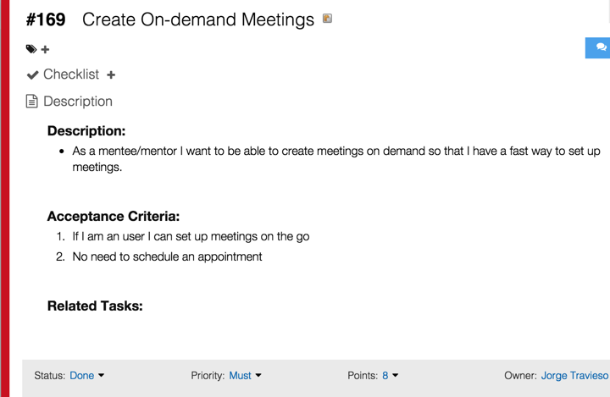

Slide 4
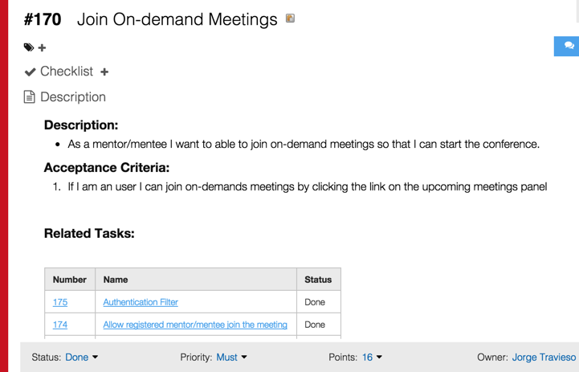

Slide 5
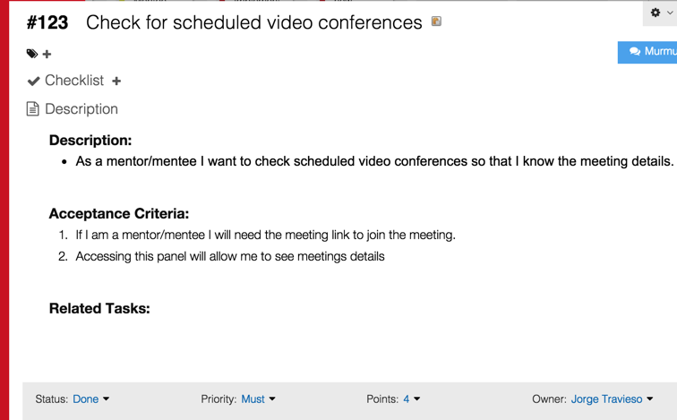

Slide 6
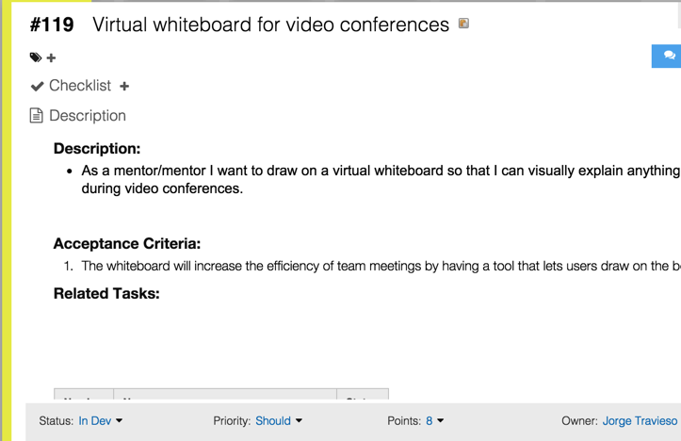

Slide 7
Sprint #2 Planning
4 User Stories
36 Story Points in Total
Estimate based on
Yii Framework study time
Documentation update time
Design and implementation

Slide 8
Self Review
User Story | Status | Accepted
Create Meetings | Done | Accepted
Join Meetings | Done | Accepted
Check Meetings | Done | Accepted
Virtual Whiteboard | In Development | No

Slide 9
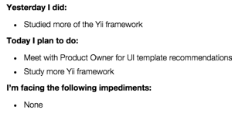
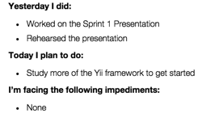
Daily Scrums
Day 2
Day 3

Slide 10
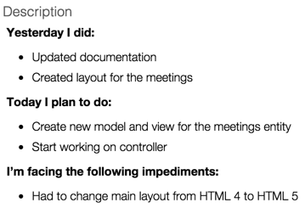
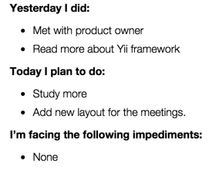
Daily Scrums
Day 4
Day 5

Slide 11
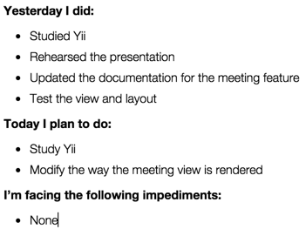
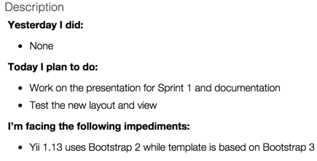
Daily Scrums
Day 6
Day 7

Slide 12
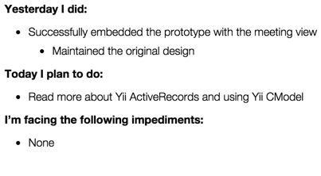
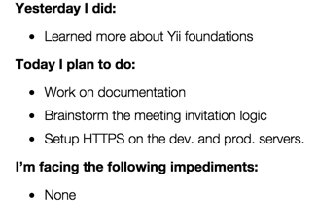
Daily Scrums
Day 8
Day 9

Slide 13
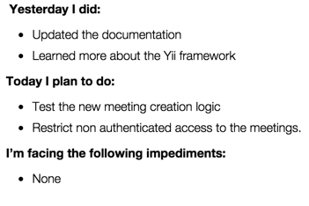
Daily Scrums
Day 10

Slide 14
Gantt Chart

Slide 15
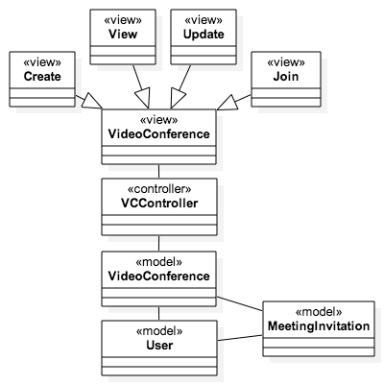
Class Diagram for VC

Slide 16
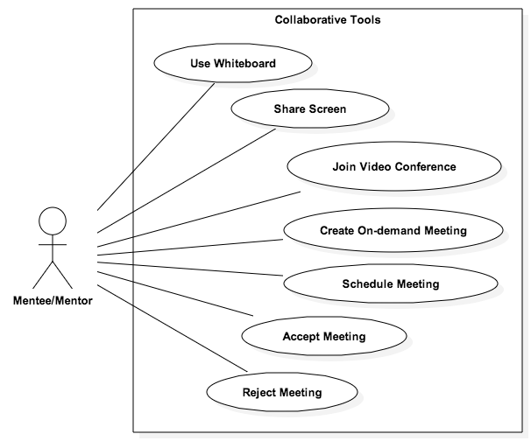
Use Case Model

Slide 17
Documentations Updates
file://localhost/Library/WebServer/Documents/coplat/Code/UserManual.docx
file://localhost/Library/WebServer/Documents/coplat/Documents/Our Docs/FSPP.docx

Slide 18
Sprint #1 Recap
One user story could not be finished
Personal Mark: 28 Points / 36 Planned
Team Mark: 50 Points

Slide 19
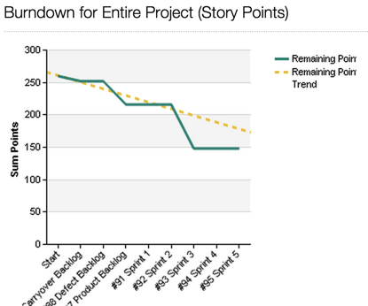
Burndown Chart

Slide 20
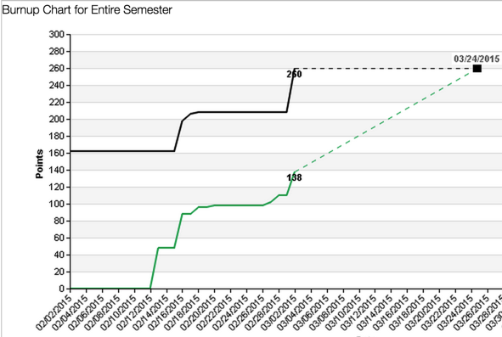
Burnup Chart

Slide 21
Demo
http://localhost/coplat/index.php/videoConference/

Slide 22
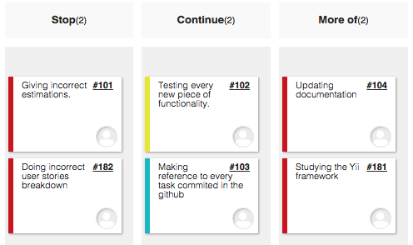
Sprint #1Retrospective

Slide 23
Sprint # 3 Planning
User Story | Status | Points
Improve VC UX | To-Do | 8
Mentor Schedule VC | To-Do | 8
Mentee Request VC | To-Do | 8
Virtual Whiteboard | In Development | 8

